Slide 1
Welcome to exposys data labs
Data Science

Slide 2
INTRODUCTION
Customer Segmentation
It is the activity of dividing a broad consumer or business market , normally consisting of existing and potential customers, into sub-groups of consumers on some type of shared characteristics
In this project we will use KMeans for segmentation and will get our target customers from the given dataset.

Slide 3
TOOL AND TECHNOLOGIES USED
Jupyter notebook {Latest Version}
Pandas
Seaborn
Matplotlib.pyplot
KMeans

Slide 4
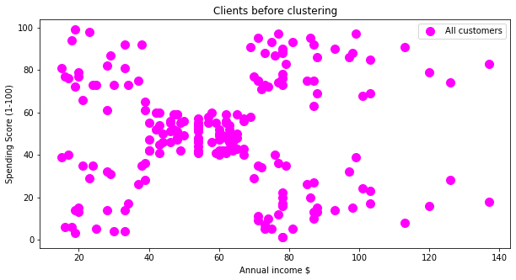
CLIENTS BEFORE CLUSTERING

Slide 5
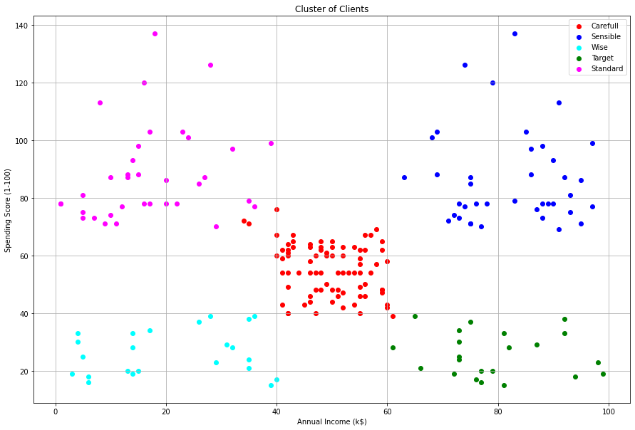
CLIENTS AFTER CLUSTERING

Slide 6
CONCLUSION-{TARGET CUSTOMERS}
In cluster(Blue-colored) we see that people have high income and high spending scores,this is the ideal case for the mall or shops as these people are the prime sources of profit. These people might be the regular customers of the mall and are convinced by the mall’s facilities.
In cluster(green colored) we see that people have high income but low spending scores,this is interesting. Maybe these are the people who are unsatisfied or unhappy by the mall’s services. These can be the prime targets of the mall, as they have the potential to spend money. So, the mall authorities will try to add new facilities so that they can attract these people and can meet their needs.

Slide 7
CONTACT US
Website http://www.exposysdata.com/
Industries Computer Software
Company size 11-50 employees
Headquarters Bengaluru, Karnataka Type
Public Company Founded 2019
Locations •Primary P.M R. Residency Ground Floor Singanayakanahalli, Yelahanka Bengaluru, Karnataka 560064 Bengaluru, Karnataka 560064, I

Slide 8
THANK YOU
FROM:
Manjot Singh Dhillon

